Slide 1

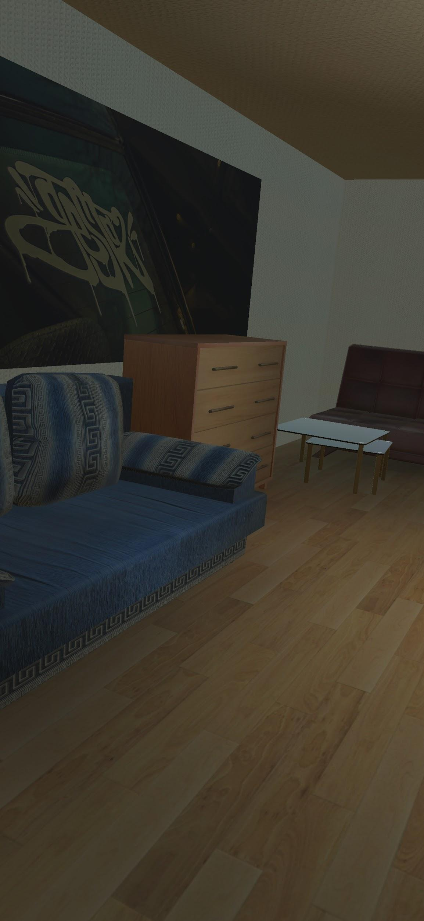
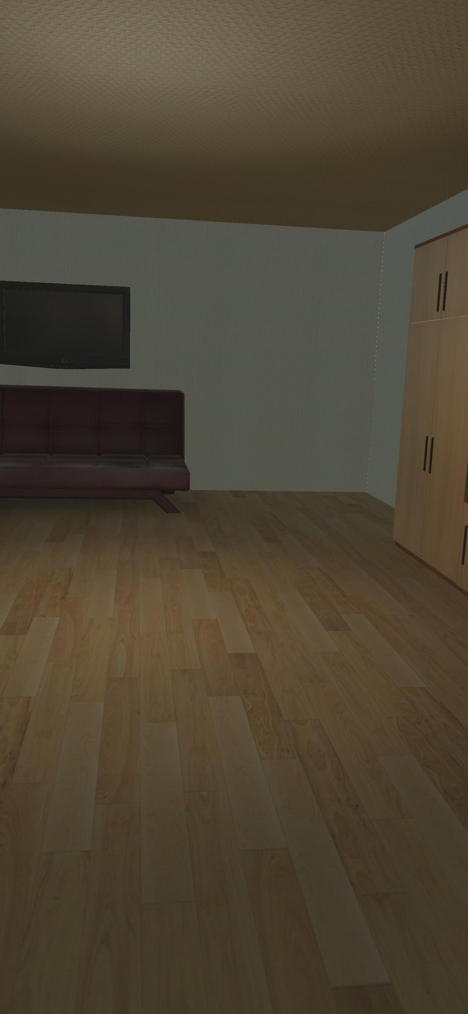
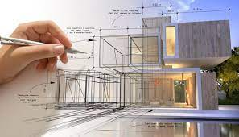


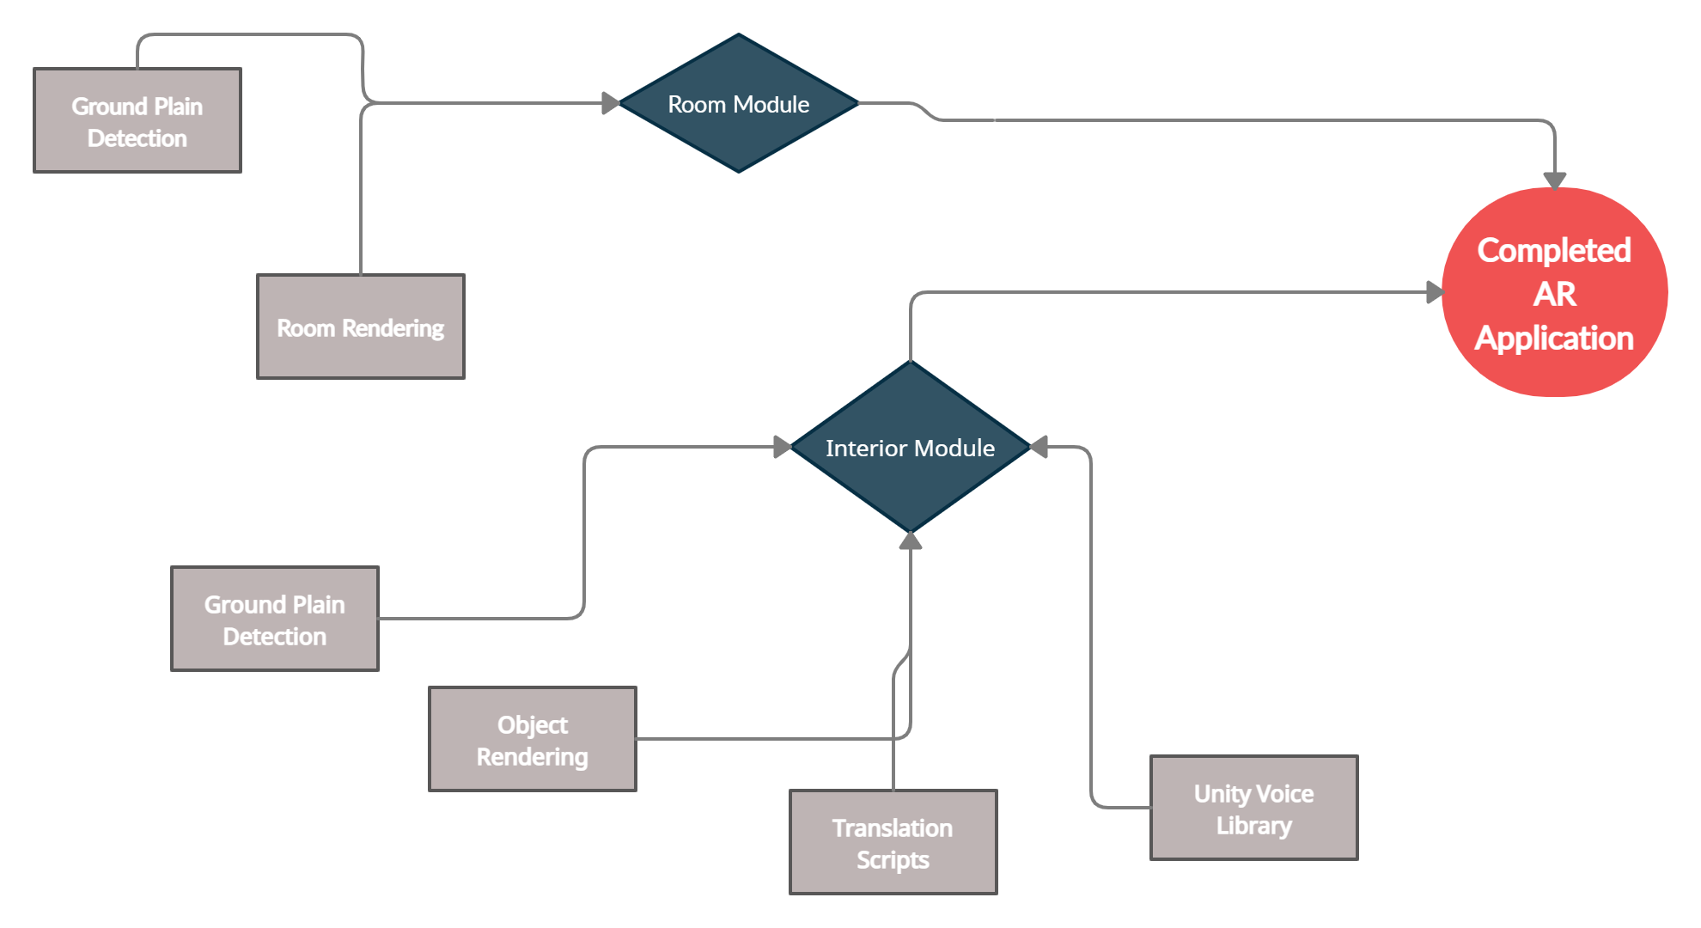









AR Application for Architects & Interior designers
Team Members:
Introduction:
Result:
Rithesh Shanmughan (1NT17CS151)
Rahul Khatri (1NT17CS142)
Sai Siddhanth A (1NT17CS158)
Utsav Mondal (1NT17CS217)
Although the idea to use AR for architecture, engineering and construction dates back to the early 1996’s and AR has actually matured from a pure research field into certain practical industrial applications, until now it has not been implemented as a real product in architecture and design. In contrast, architecture and design communities apparently have the knowledge of the operations/tasks that AR could potentially enhance as well as the motivation to bring in this new technology for improving the current practices
Under the guidance of:
Mrs. Nirmala J S
Methodology:
Conclusion & Future Scope:
Objective:
Integration
‹#›
References:
Virtual Reality Practice in Architecture Design; Ping Su, Shuo Wang
AR Interior Designer: Automatic Furniture Arrangement using Spatial and Functional Relationships; Jeff K.T. Tang , Wan-Man, Lau -Kit Chan, Kwok-Ho
Approach to The Interior Design using Augmented Reality Technology ;Jiang Hui
Notes:
You can add your presentation notes here. This presentation template for research posters is fully editable so text, graphics and content can be updated to fit your own research needs.
Download more poster presentation templates from FPPT.com

